Slide 1


Development of a web based Recruitment Proces system for the hr group For a company. grouP No-44
Abhishek pandita (06)
Siddeshwari patil (07)
Abhijeet pawar (08)
Saakshi pawar (09)
Megh podar (10)
EMPLOYABILITY SKILL DEVELOPMENT PROGRAMM

Slide 2


Flow of Presentation
Introduction
Problem Statement
Description
Implementation
Discussion
Conclusion
EMPLOYABILITY SKILL DEVELOPMENT PROGRAMM

Slide 3
Introduction
Human Resource (HR)management has become one of the essential functions in an organization. Therefore the HRD has to ensure that the welfare of employees are taken into consideration in their overall tasks.
Recruitment refers to a process by which potential candidates are selected through venture is gone for building up an online and focal Recruitment Process System for the HR Group for an organization. A few highlights of this framework will make opportunities, putting away Applicants information, Interview process starts, Scheduling Interviews, Storing Interview comes about for the candidate lastly Hiring of the candidate. Reports might be required to be produced for the utilization of HR gathering.
EMPLOYABILITY SKILL DEVELOPMENT PROGRAMM

Slide 4
Problem Statement
The problems faced in web development recruitment by the HR group are attracting top talent, lack of quality candidates, technology misalignment.
Painfully slow decision-making is one of the self-inflicted problems in the recruitment and selection process. Job-seekers are showing little patience for employers who expect them to endure multiple rounds of interviews over the course of several weeks. And in a tight labour market, they don’t have to bide their time. An employer who prolongs the vetting process risks missing out on tapping into the best of a shrinking talent pool.
EMPLOYABILITY SKILL DEVELOPMENT PROGRAMM

Slide 5
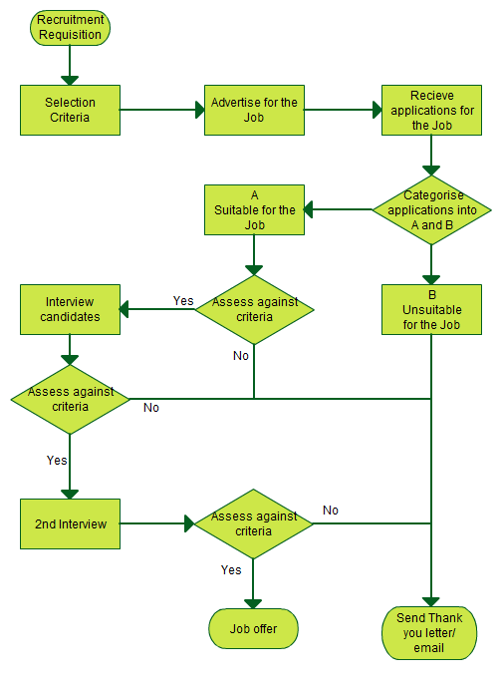
description
The project will focus on admin creates a job applicants profile, creates a CVV, education and experience profile for applicant selection.
EMPLOYABILITY SKILL DEVELOPMENT PROGRAMM

Slide 6
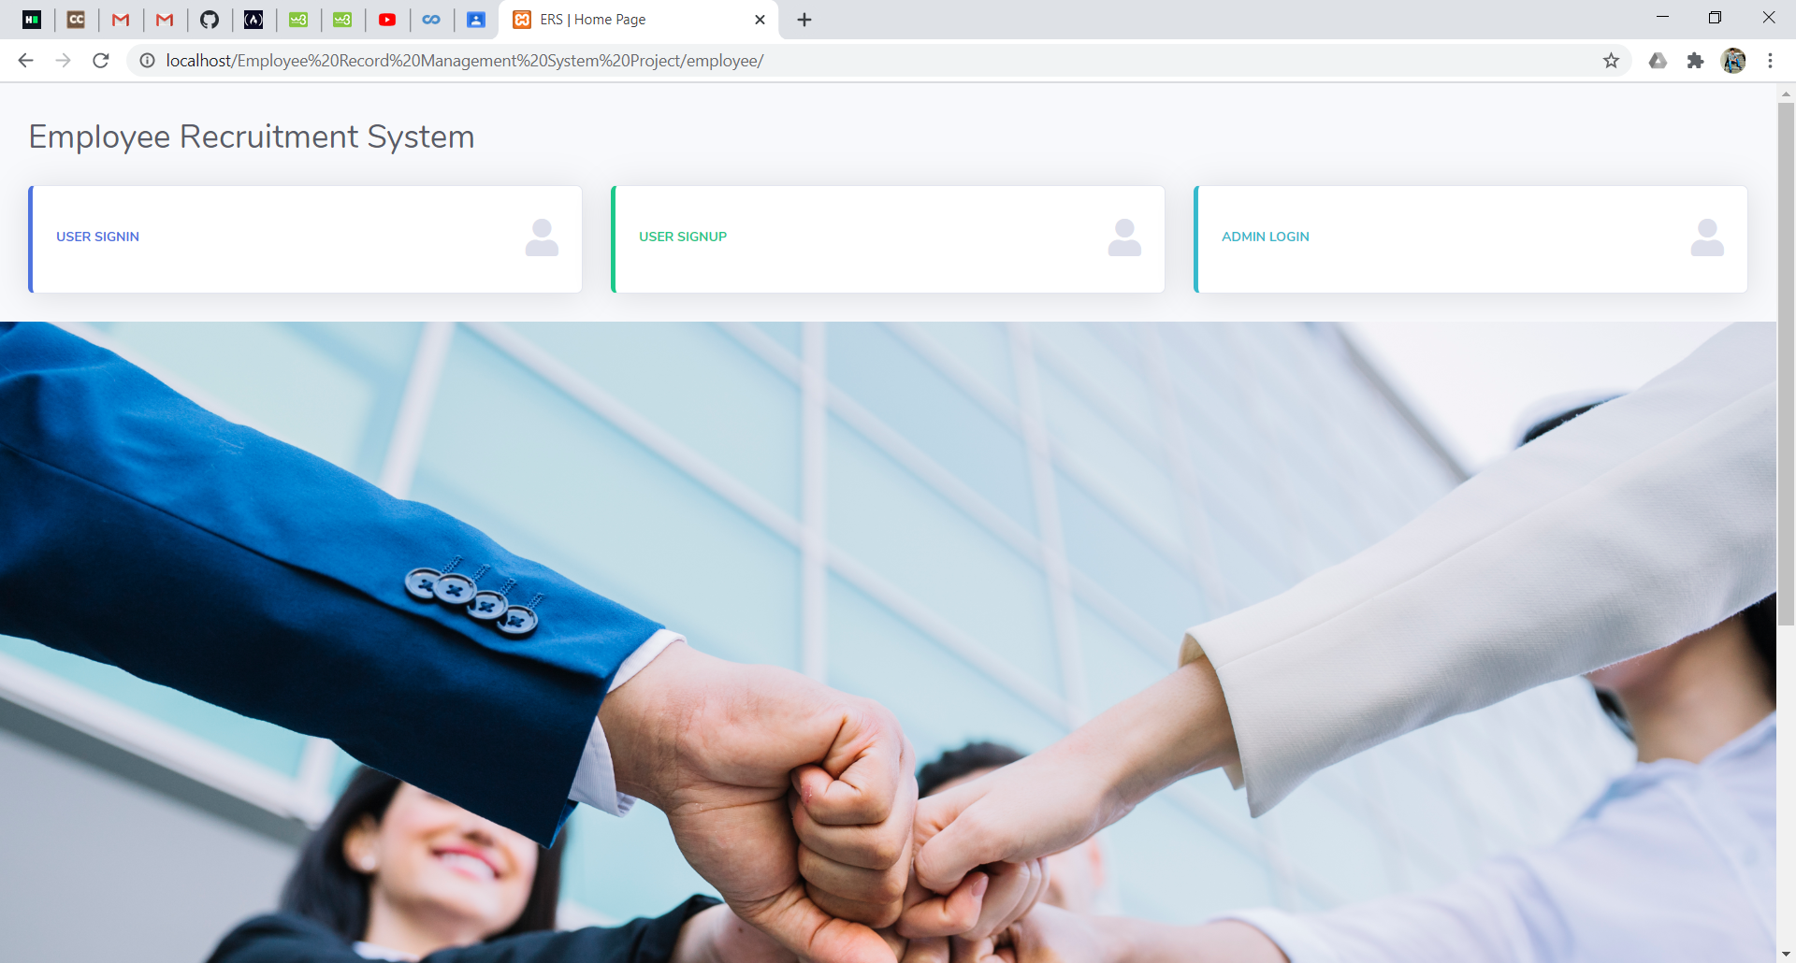
implementation
Software used in project is XAMPP
We have used scripting Language as HTML, CSS,PHP
EMPLOYABILITY SKILL DEVELOPMENT PROGRAMM

Slide 7
Conclusion
It has been shown that companies can increase the efficiency of the recruitment process and significantly cut costs, by integrating e-recruitment systems in their HR management infrastructure.
On the basis of the conducted research, we can conclude that the use of modern technologies in the recruitment and selection process is not only a guarantee of completion with the intended effect of a given project, but also causes a real improvement in the recruitment process, which allows, in particular for the business sector to reduce costs and time.
EMPLOYABILITY SKILL DEVELOPMENT PROGRAMM

